Slide 1
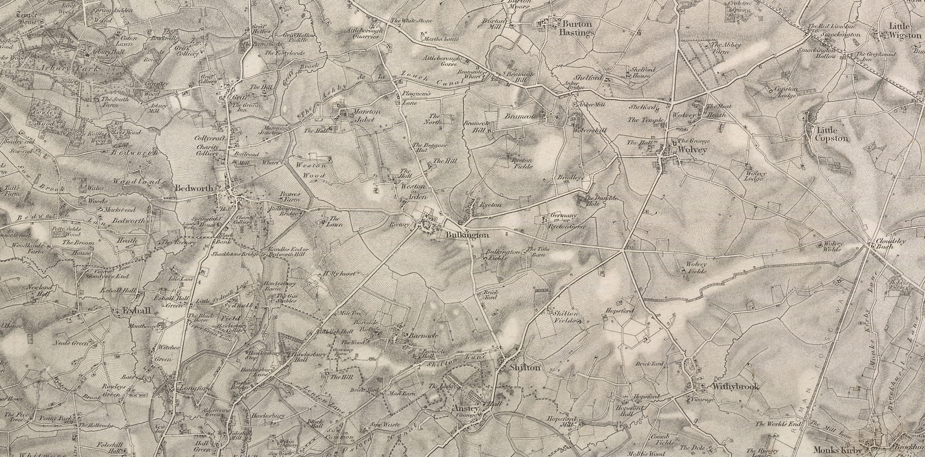
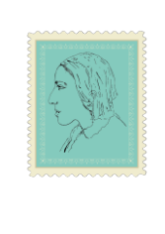


Silas Marner:
The Weaver of Raveloe
Lesson 1: Communities – Woven Together & Spun Apart
image www.visionofbritain.org.uk (c) 2004-2015 of the Great Britain Historical GIS Project and the University of Portsmouth. This work is licensed under the Creative Commons Attribution 4.0 International License

Slide 2
What is Community?
What communities do you belong to?
What ways do you communicate/connect with your different communities?
Do you have different ways of communicating with different groups (skype; texts; face to face)?
Does that change how you connect with each other?
What breaks/stretches your connections to your communities?

Slide 3
Map Your Communities
On A3 paper put your name at the centre.
Name each community you are part of in a different bubble.
Draw lines connecting yourself to your different communities.
Add a label to each line explaining how you connect to that community.
We have completed an example here for Silas Marner and his communities. You might want to come back to this in later lessons to see if you agree with it or want to change anything.

Slide 4
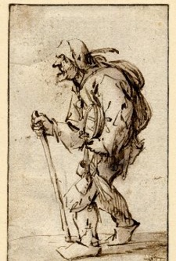
Silas Marner, Migration & Community
Silas Marner is set 200 years ago but explores constant human issues of communities, exclusion, and change.
The writer, George Eliot, was a woman who had to leave her own home because of the life she wanted to lead and had to publish under a man’s name to keep her secrets safe (her real name was Mary Ann Evans).
In the story Silas has to emigrate from a busy city in the North to a small village further south.
Eliot describes migration at the opening of the novel. What it is like moving to a new community, what problems can that bring?
[image c. British Museum Trustees]

Slide 5
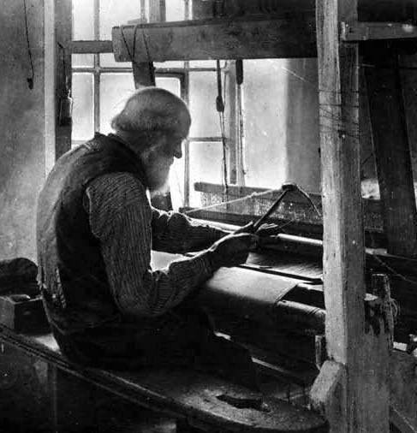
Analysis: Silas and the Village Extract 1
What are the differences between the country folk and the travelling weavers described in this opening?
Why are the country folk suspicious of the weavers?
What are the effects on individuals of being excluded from the countryside community?
[Image via http://www.cottontown.org]

Slide 6

Extract 2:
How do we know that Silas Marner is not part of the community?
What additional characteristics does Silas Marner have that make him even more likely to be excluded from the community in his village of Raveloe?
Why do you think the narrator discusses the importance of imagination in this passage?
How might imagination be important to the process of accepting change or new experiences in a community?
Extension: ‘the questionable sound of Silas’s loom’. Why is it ‘questionable’? What is different about Silas’s work to that of other labourers in the village?
Discussion:
Is community always a good thing?
How do communities change?
How do we move between communities?

