Slide 1
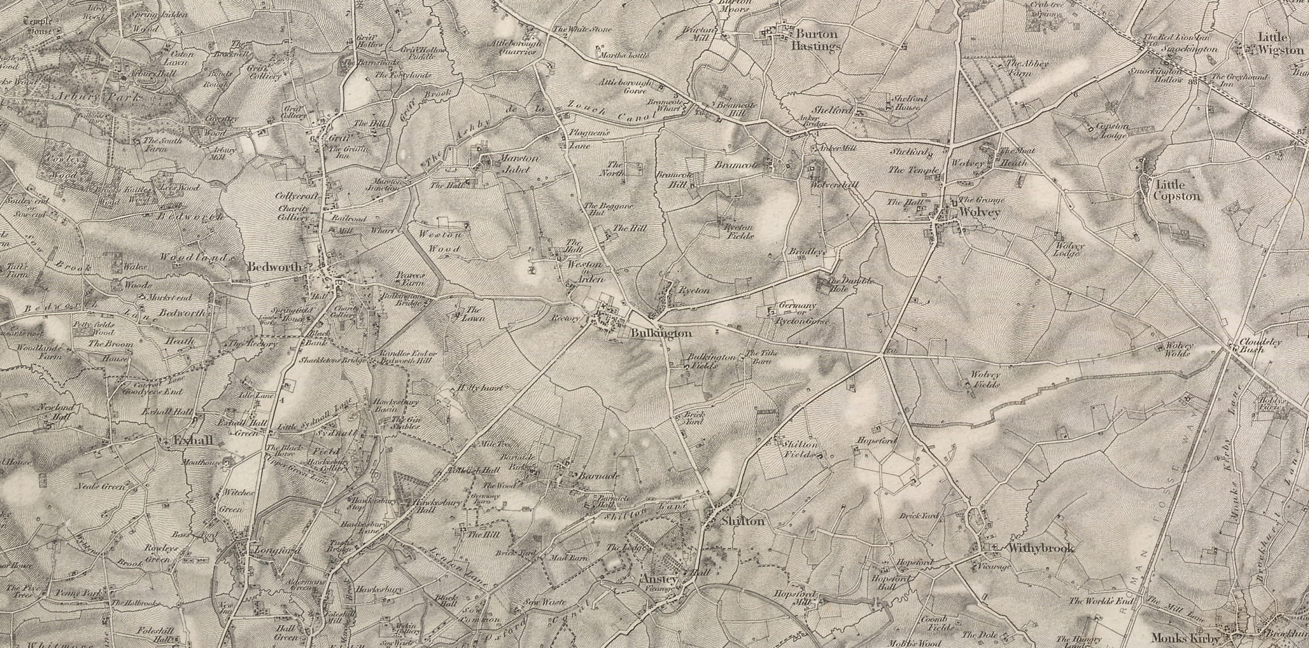
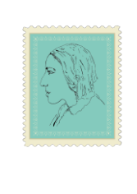


Silas Marner:
The Weaver of Raveloe
Lesson 5: Making Communities with Objects
image www.visionofbritain.org.uk (c) 2004-2015 of the Great Britain Historical GIS Project and the University of Portsmouth. This work is licensed under the Creative Commons Attribution 4.0 International License

Slide 2
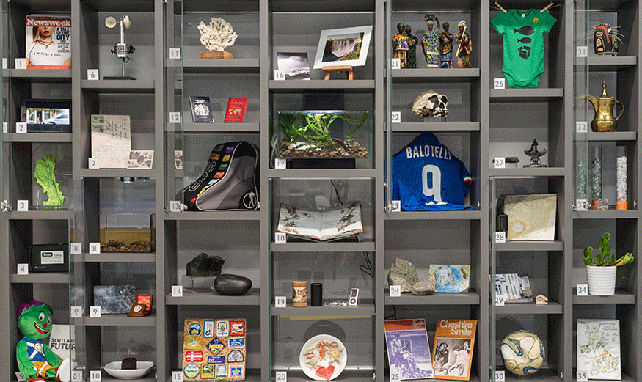
Starter: What objects matter to you, are precious or speak of home?
Discuss with partner how they feel; how they make you feel; where you keep them; why these things?

Slide 3
Silas’s objects of affection: Jug, loom, gold
Extract 1:
Why is the brown jug so important to Silas?
Why does he keep it after it breaks?
Write for 5 minutes from the point of view of the jug. What does it feel about Silas?
Extract 2:
‘like all objects to which a man devotes himself, they [the gold and the loom] had fashioned him into correspondence with themselves.’
How is Silas like his loom or his gold?
How can an object change a person?
Can objects having power over us?
Can you see any connections between the way Silas is described in the first paragraph and the jug in the next?
l

Slide 4
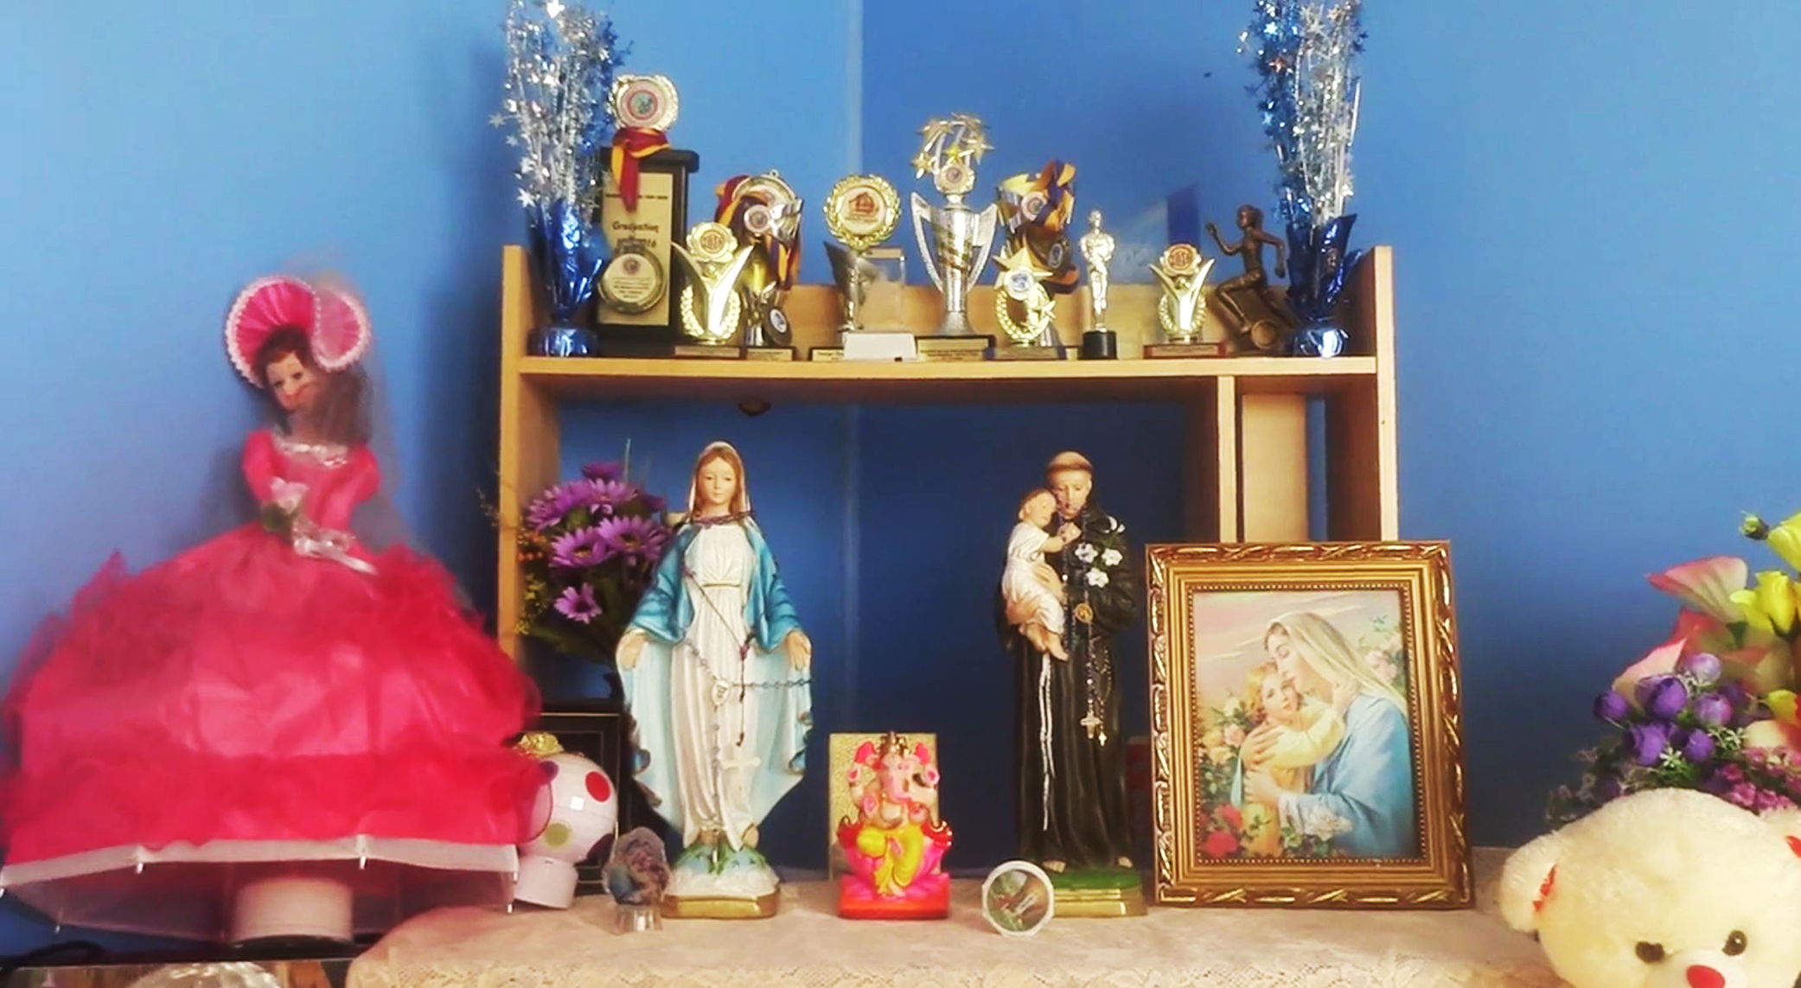
Migration, Community, Mementoes
Researchers in 'cultural geography', such as Divya Tolia Kelly, and Charishma Ratnam have shown the importance of keepsakes and collections of objects from ‘home’ in the lives of migrants in contemporary London and elsewhere. The objects play a part in resettling or connecting new and old communities.
[image taken from Charishma Ratnam, ‘Using Visual and Mobile Methods in the Home’ Visual Ethnography 8.1 (2019)]

Slide 5
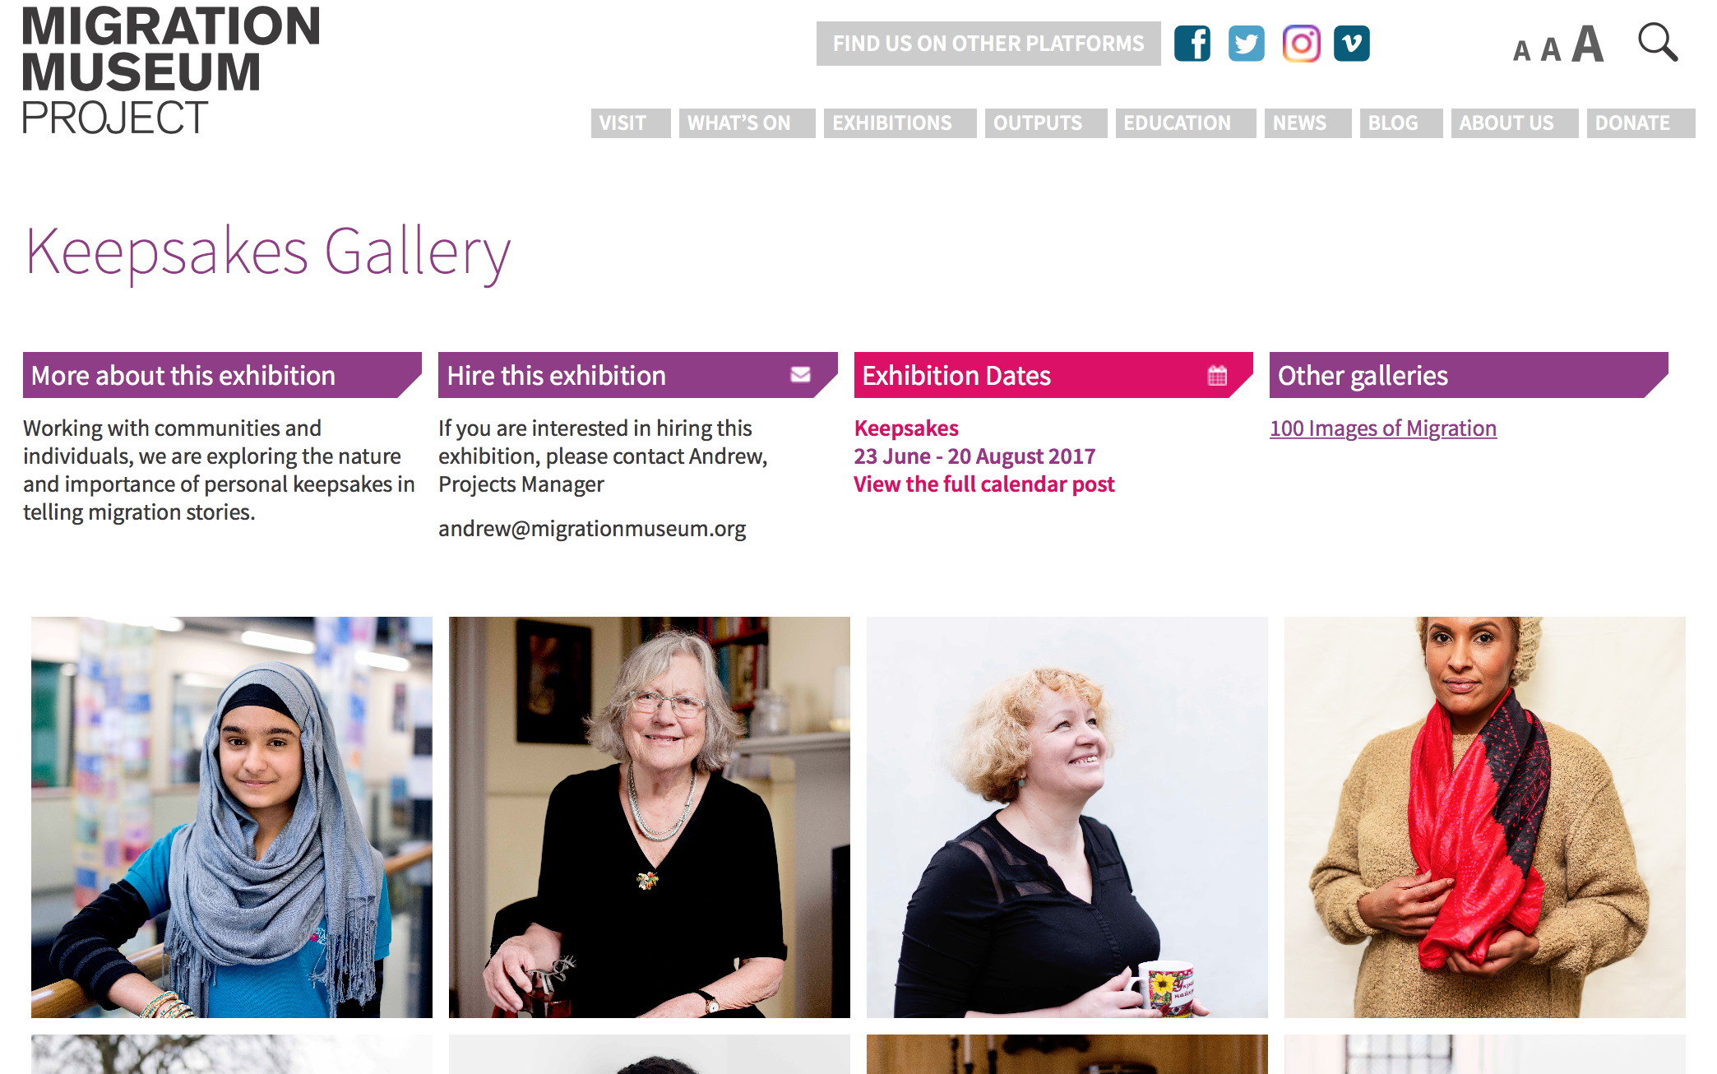
Migration Museum and Collecting Objects
The Migration Museum has an online exhibition of the keepsakes and special objects of migrants from around the world to Britain here:
https://www.migrationmuseum.org/a-keepsake-is-a-very-special-thing/
https://www.migrationmuseum.org/keepsakes-gallery/
Are there any connections / contrasts to be made between these objects and Silas’s attachment to the objects in his life in Raveloe?
Are his objects something more to him than keepsakes?

Slide 6
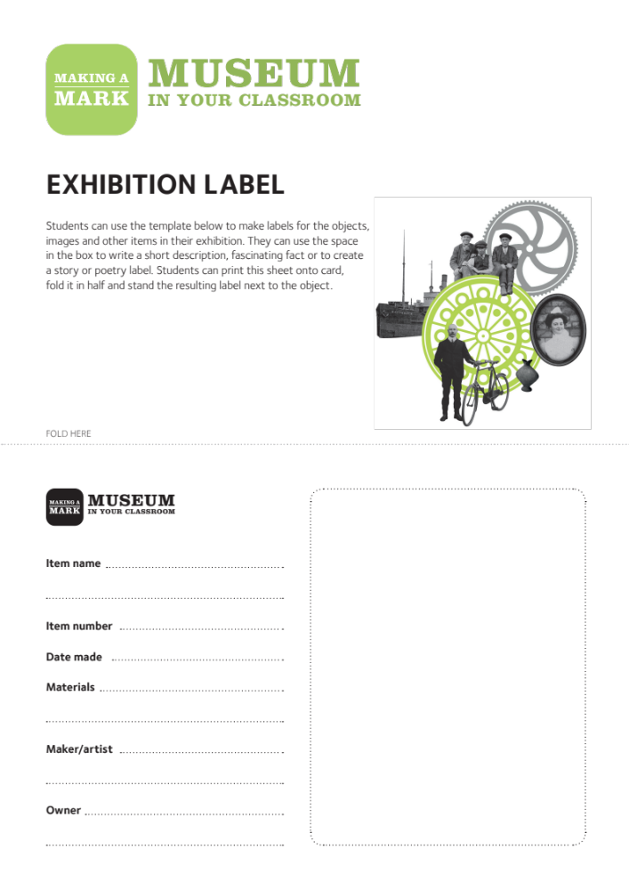

Homework:
A Museum of You
Choose two different objects in your home that are precious to you. Write a museum object label each item using this template. https://www.npg.org.uk/assets/microsites/makingamark/docs/exhibition_label.pdf
Fill in the blank square with four sentences recounting the part of this object in your daily life. How do you handle it? What do you use it for? Why does it matter to you? Do you think it might shape you in the way Silas’s objects shape him?!

