Slide 1
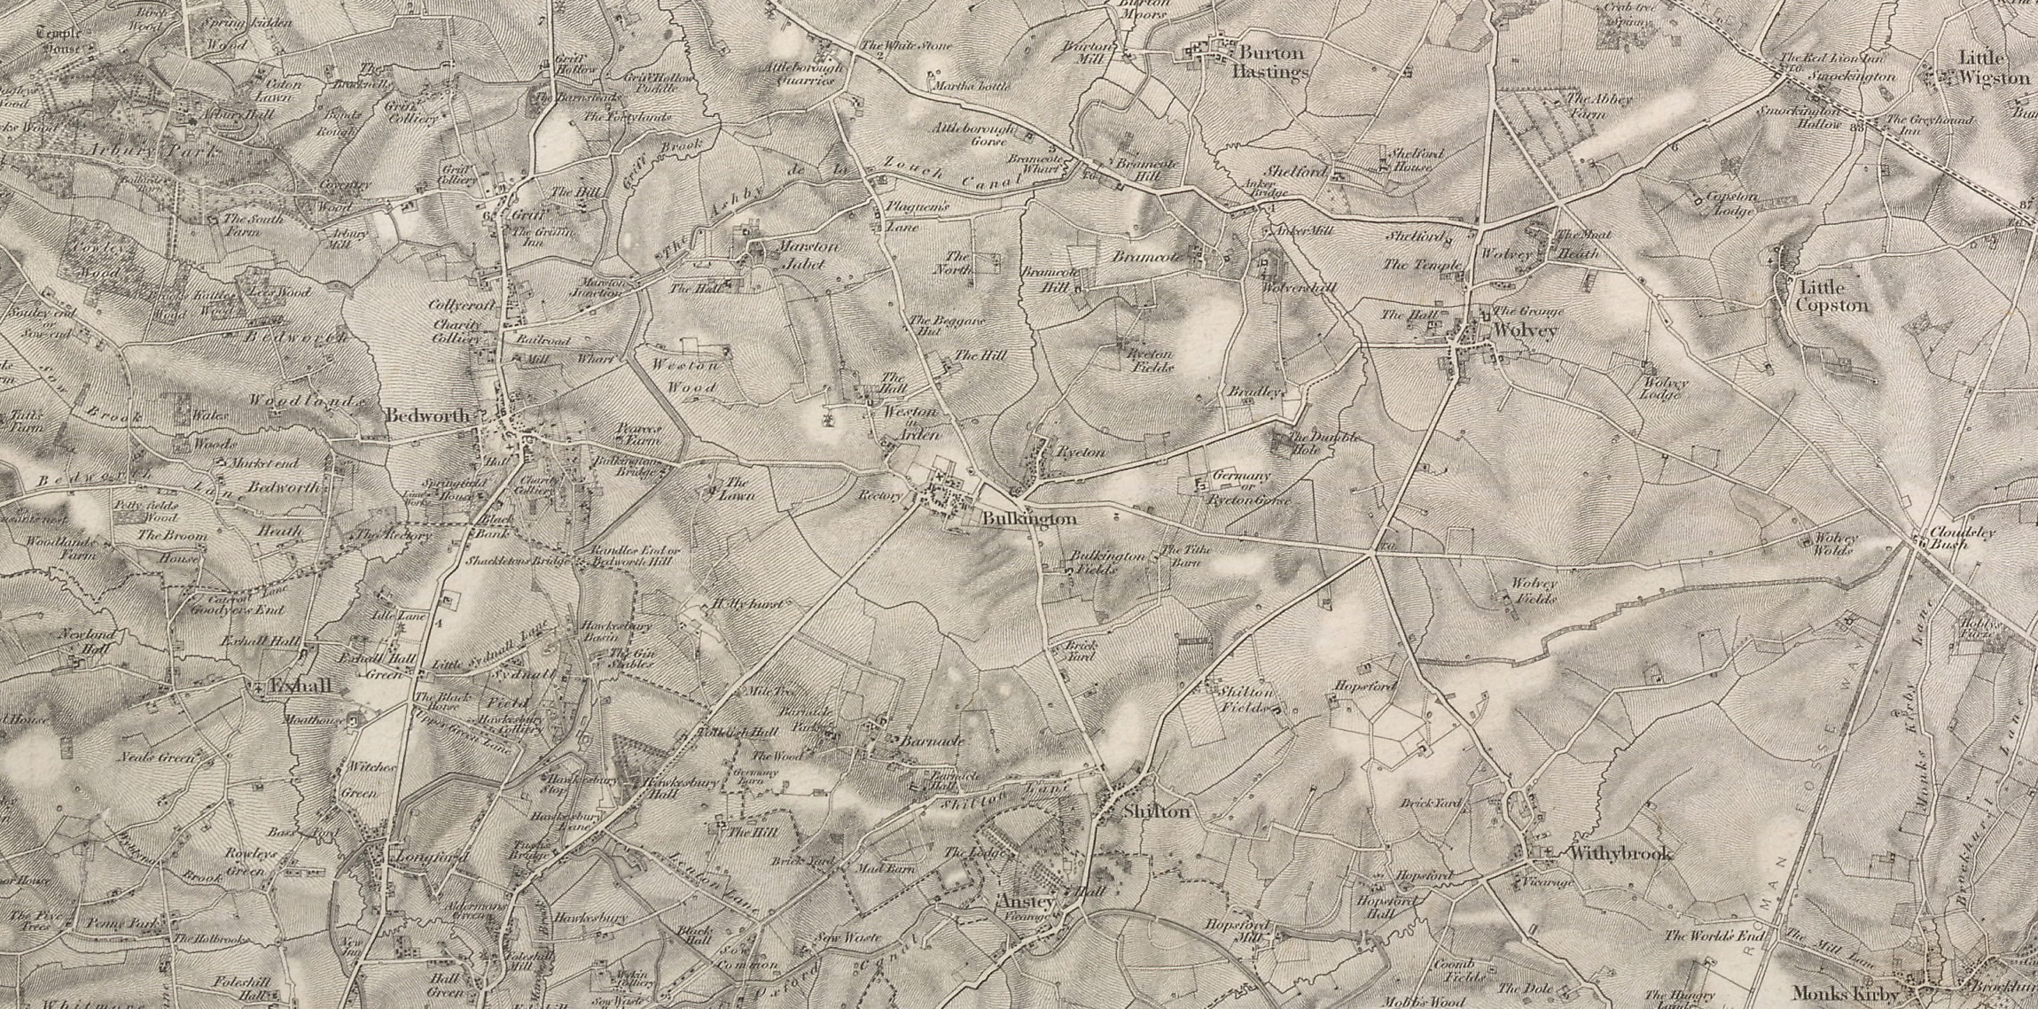



Silas Marner:
The Weaver of Raveloe
Lesson 7: Gender
image www.visionofbritain.org.uk (c) 2004-2015 of the Great Britain Historical GIS Project and the University of Portsmouth. This work is licensed under the Creative Commons Attribution 4.0 International License

Slide 2
Starter
Knowledge Check
With your partner:
List at least three jobs that females could do in the nineteenth century (Victorian era) – guess if you don’t know
List three jobs that females were not permitted to do - guess if you don’t know
(5 minutes)
Extension: Why were females not permitted to carry out certain roles? Can you guess (infer)?

Slide 3
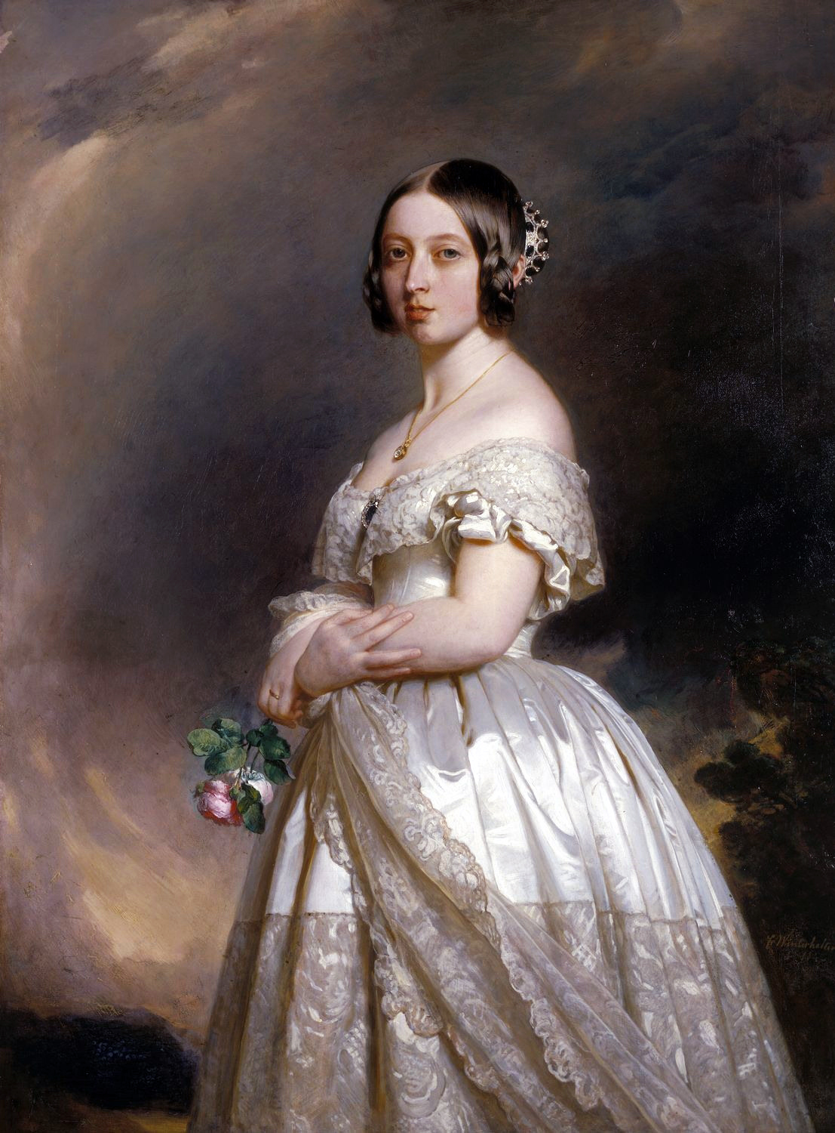
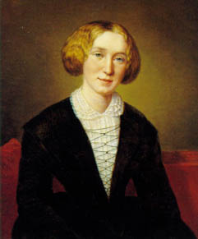
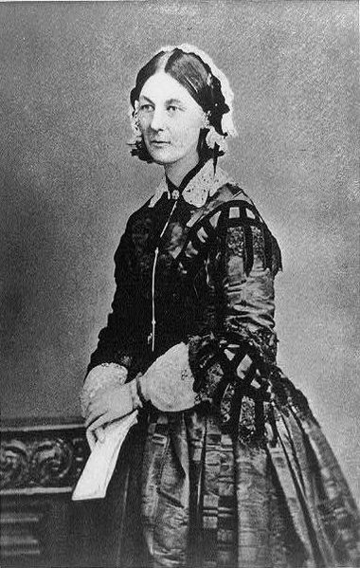
Powerful Victorian Women:
Who are these women?

Slide 4
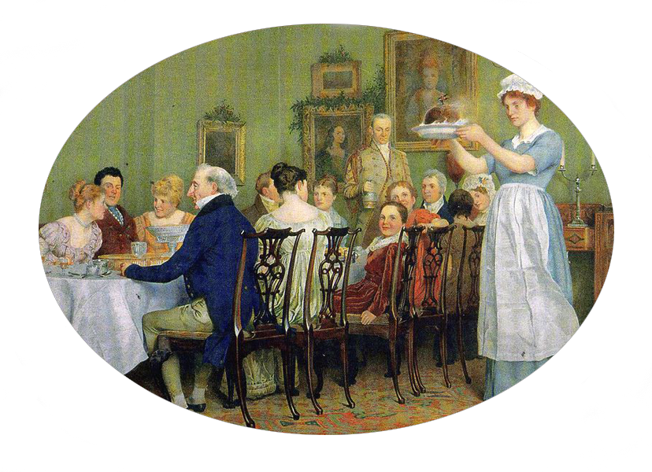
Chapter 11:
The New Year’s Eve party
- recap

Slide 5
Chapter 12
Read the opening to Ch. 12
In your group, you will:
Answer two questions on the text and make notes in your book
Feedback to the class
You have 15 minutes to discuss as a group and note down your answers in your books

Slide 6
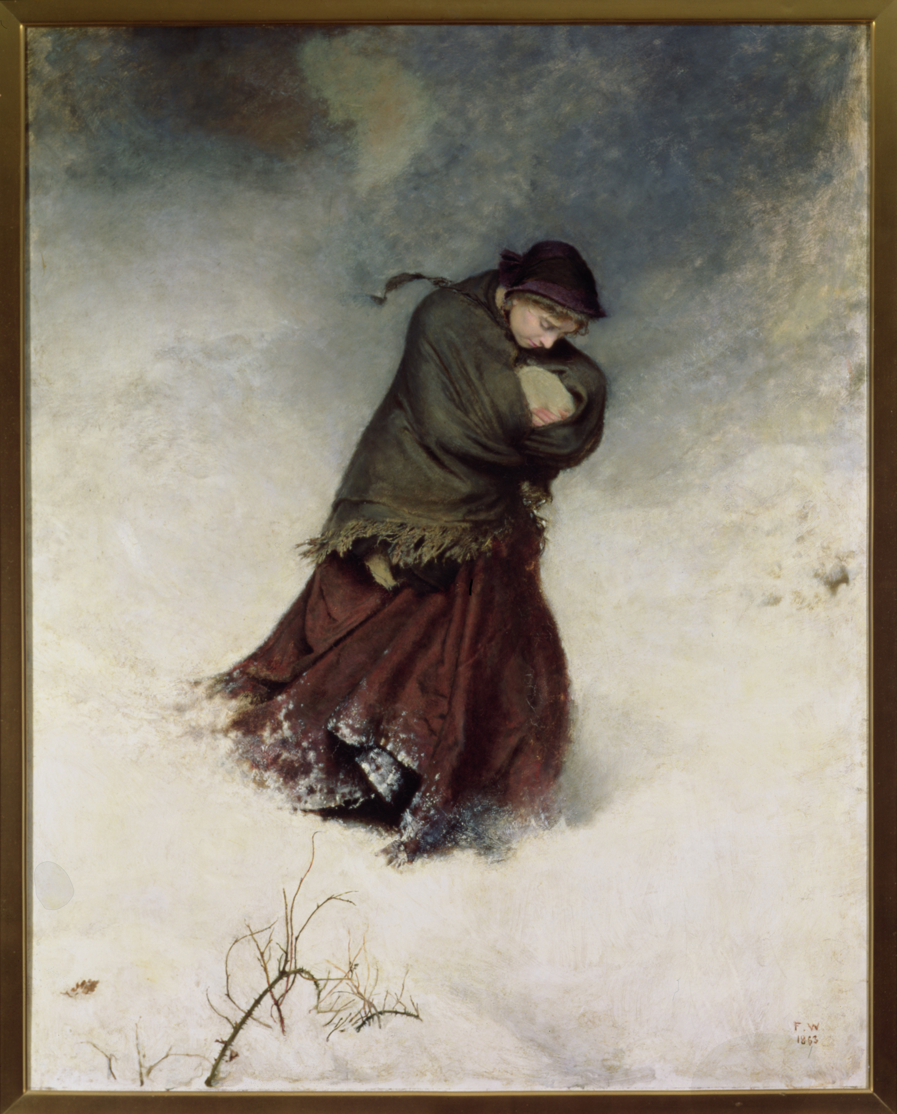

Plenary
Write a paragraph on Molly’s situation
using evidence from the text and including a point from your group’s discussion
The Lost Path
Frederick Walker, ARA (1840-1875)
1863

