Slide 1
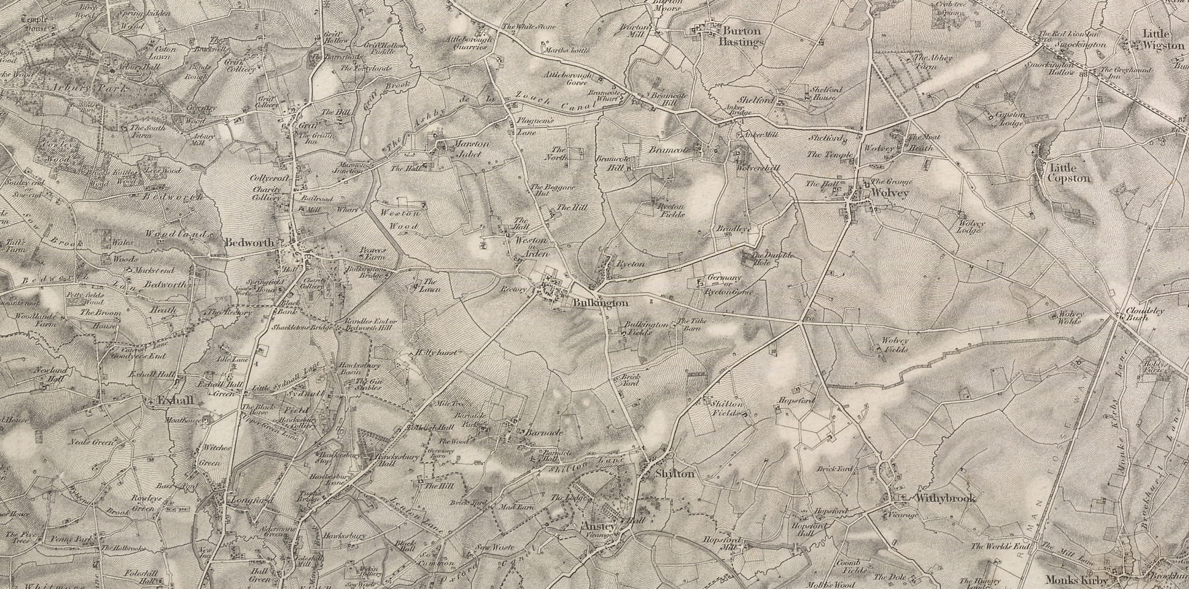
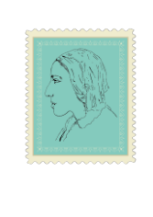


Silas Marner:
The Weaver of Raveloe
Lesson 8: Community & Change
image www.visionofbritain.org.uk (c) 2004-2015 of the Great Britain Historical GIS Project and the University of Portsmouth. This work is licensed under the Creative Commons Attribution 4.0 International License

Slide 2
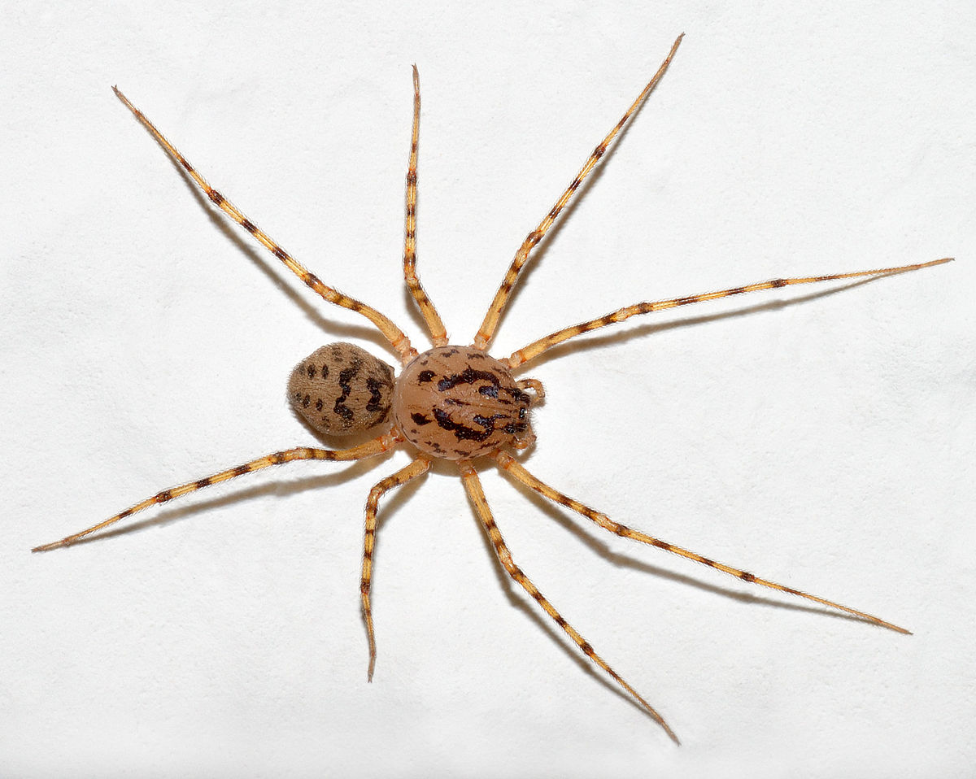
Starter: Remembering Silas at the beginning
Thinking back to the start of the book, discuss with your partner how Silas connects to the community of Raveloe at the opening.
Where does he go in the village?
Why does he go there?
What does he look at and touch?
See recap extracts from Chapter 2:
…imagine what was the effect on a simple weaver like Silas Marner, when he left his own country and people and came to settle in Raveloe. Nothing could be more unlike his native town, set within sight of the widespread hillsides, than this low, wooded region, where he felt hidden even from the heavens by the screening trees and hedgerows. There was nothing here, when he rose in the deep morning quiet and looked out on the dewy brambles and rank tufted grass, that seemed to have any relation with that life centring in Lantern Yard, …His first movement after the shock had been to work in his loom; and he went on with this unremittingly, never asking himself why… He seemed to weave, like the spider, from pure impulse, without reflection.
This Photo by Unknown author is licensed under CC BY-SA.

Slide 3
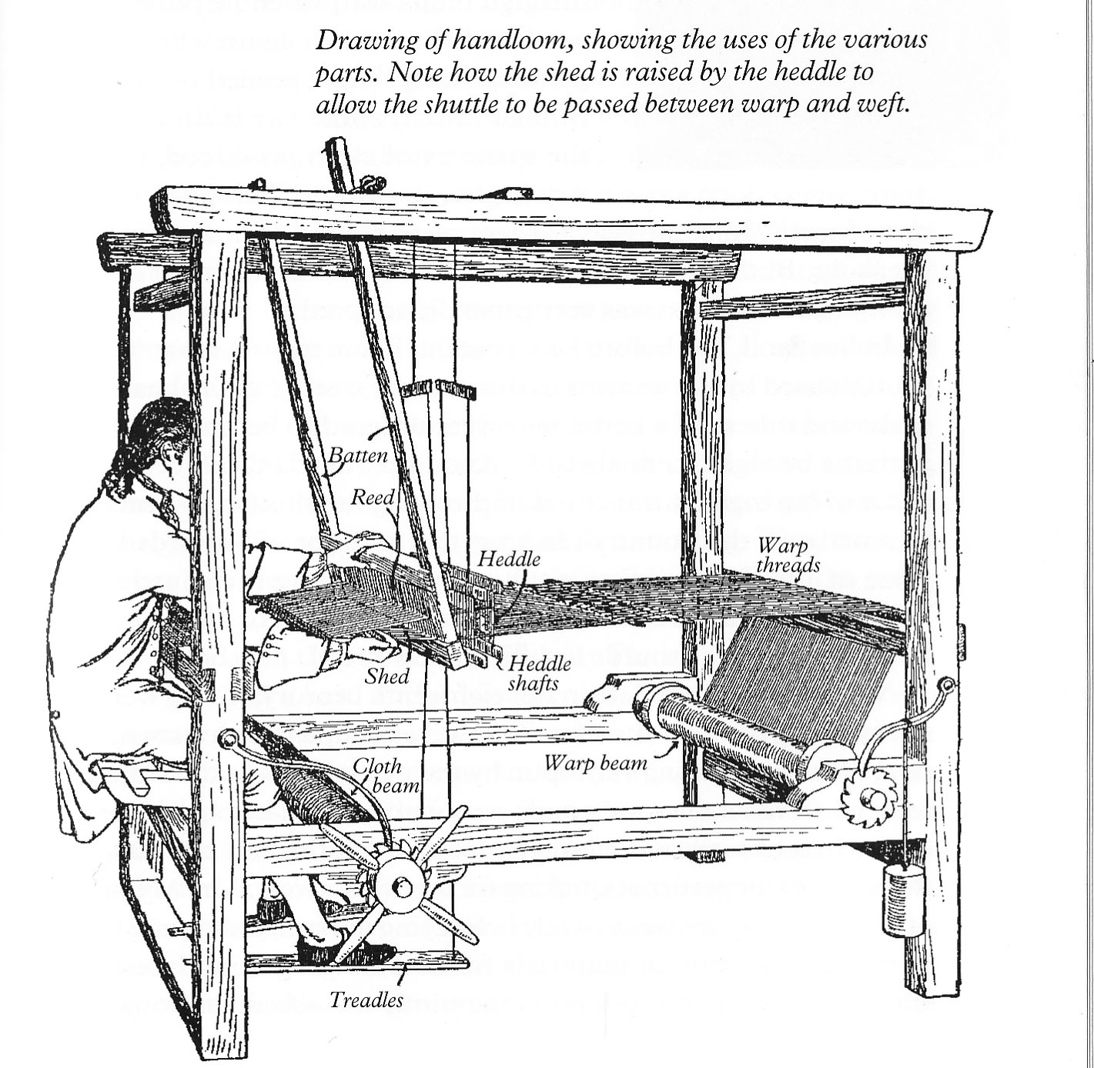
Weaving new connections
Read Extract 1:
How does Eppie change Silas’s place in Raveloe?
Find two examples of the language of connection and of movement/mobility in the passage.
How and why does Silas move through the landscape with Eppie?
Extension: As Eppie’s mind grows in knowledge Silas’s mind was ‘growing into memory’. What does this imply about his mind/self before adopting Eppie?

Slide 4
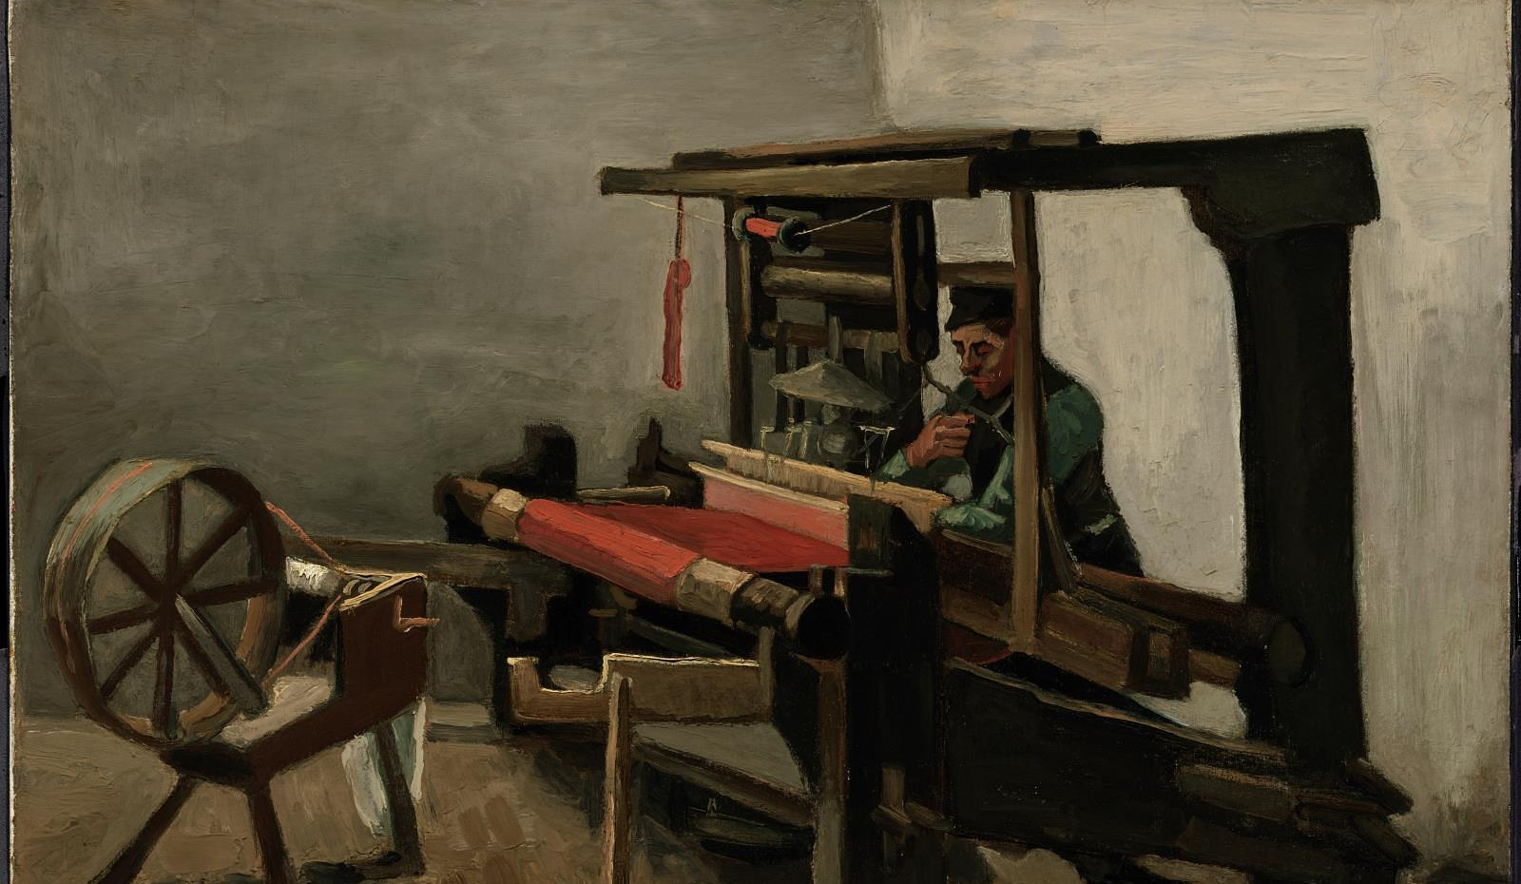
Vincent Van Gogh, ‘Weaver’ (1884)
Van Gogh was deeply influenced by many of Eliot’s novels, Silas Marner in particular. He depicted handloom weavers in his home town of Nunenen in the Netherlands, sometimes with children tied to them as in this story.
Museum of Fine Art, Boston, Tompkins Collection—Arthur Gordon Tompkins Fund

Slide 5
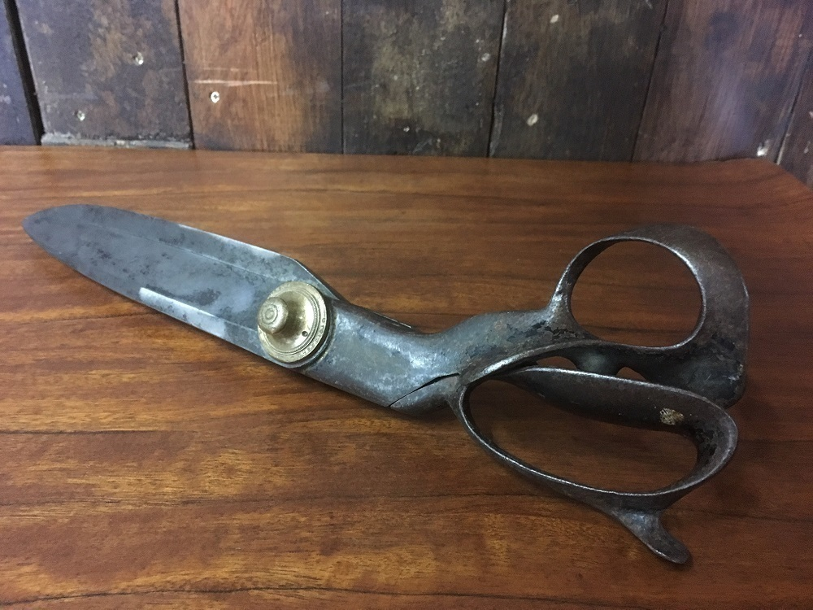
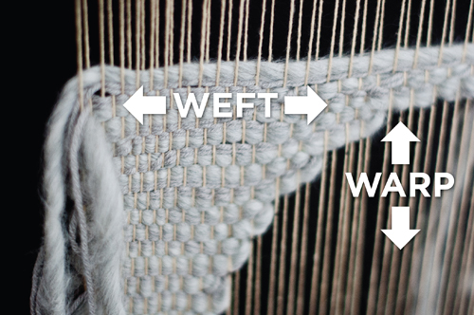
Weaving together and cutting free: symbolism in the novel. Which images best symbolizes community - or can it be both?

Slide 6
Eppie cuts herself free from the loom – and who has to follow her?
What do you make of Eppie cutting herself free?
How does her act symbolise other kinds of freedom gained in the novel?
Who else is set free?
Who does not get to be free or to change?
Why do you think the image of weaving is so important in the novel?
How might the symbol of woven material relate to the image of community in the novel?

Slide 7
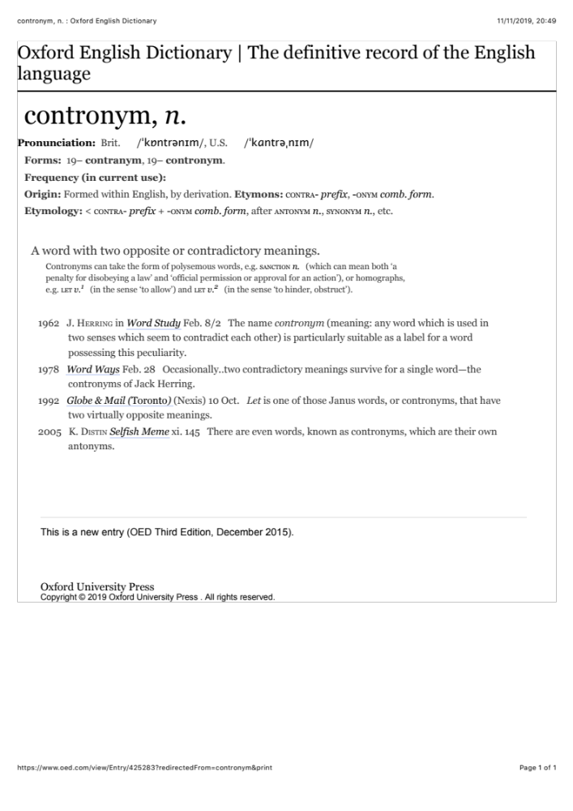

Raveloe ; Ravel/oe – what’s in a name?
‘Ravel’ is a contronym, also known as auto-antonym or ‘janus word’ in that it has two meanings, each of which is the opposite of the other. Other examples include ‘cleave’, ‘dust’, ‘overlook’.
What are the two meanings of ‘ravel’?
Why might it be significant in relation to the symbolism of the village in Silas’s story?

